Slide 1
Non-communicable diseases
(NCDs) and life style changes
Assistant professor
Dr. Abdulfattah Hama Rahim Hawramei
M.Sc -Community Medicine F.I.B.M.S- Community Medicine
College of Medicine-University of Sulaimani
Non-communicable diseases

Slide 2

objectives
At the end of this Presentation, you will be able to understand and clarify:
Introduction to non communicable diseases.
Life styles and related to health
Prevention of NCD
Key Challenges of Non-Communicable Diseases in Iraq.
Potential Solutions and Recommendations:
Non-communicable diseases

Slide 3

Definition
They are not passed from person to person.
They are of long duration and generally slow progression.
An impairment of bodily structure that necessitates a modification of the patient's normal life, and has persisted over an extended period of time.
Non-communicable diseases

Slide 4
Some authors maintain that :
An acute illness usually consists of a simple episode of fairly short duration from which the patient returns to normal activity.
A chronic illness is one of long duration in which the patient is permanently incapacitated to a more or less marked degree.
Non-communicable diseases

Slide 5
The Commission on Chronic Illness in USA has defined "chronic diseases" as "comprising all impairments or deviations from normal, which have one or more of the following characteristics :
are permanent.
leave residual disability.
are caused by non-reversible pathological alteration.
require special training of the patient for rehabilitation.
expected to require a long period of supervision, observation or care“.
Non-communicable diseases

Slide 6
New statistics
Non communicable diseases (NCDs) kill 41 million people each year, equivalent to 74% of all deaths globally.
Each year, 17 million people die from a NCD before age 70; 86% of these premature deaths occur in low- and middle-income countries.
Of all NCD deaths, 77% are in low- and middle-income countries.
https://www.who.int/news-room/fact-sheets/detail/noncommunicable-diseases
Non-communicable diseases

Slide 7
Cardiovascular diseases account for most NCD deaths, or 17.9 million people annually, followed by cancers (9.3 million), chronic respiratory diseases (4.1 million), and diabetes (2.0 million including kidney disease deaths caused by diabetes).
These four groups of diseases account for over 80% of all premature NCD deaths.
Tobacco use, physical inactivity, the harmful use of alcohol, unhealthy diets and air pollution all increase the risk of dying from an NCD.
Detection, screening and treatment of NCDs, as well as palliative care, are key components of the response to NCDs.
Non-communicable diseases

Slide 8
Types of NCDs
Non-communicable diseases (NCDs) include different kinds of diseases:
Cardiovascular
Cancer.
Chronic nonspecific respiratory diseases (e.g., chronic bronchitis,emphysema, asthma).
Diabetes.
Obesity.
Nervous and mental diseases
Musculo-skeletal conditions such as arthritis and allied diseases.
Permanent results of accidents.
Senility.
Blindness.
Non-communicable diseases

Slide 9

Is
NCD
preventable?
Non-communicable diseases

Slide 10
These diseases are preventable.
Up to 80% of heart disease, stroke, and type 2 diabetes and over a third of cancers could be prevented by eliminating shared risk Factors.
Mainly preventable risk factors are tobacco use, unhealthy diet, physical inactivity and the harmful use of alcohol.
Non-communicable diseases

Slide 11

Why NCD happen?
Non-communicable diseases

Slide 12
Urbanization
industrialization
modernization
Life style changes
Non - Communicable diseases
Chronic diseases
Lifestyle Diseases
Non-communicable diseases

Slide 13
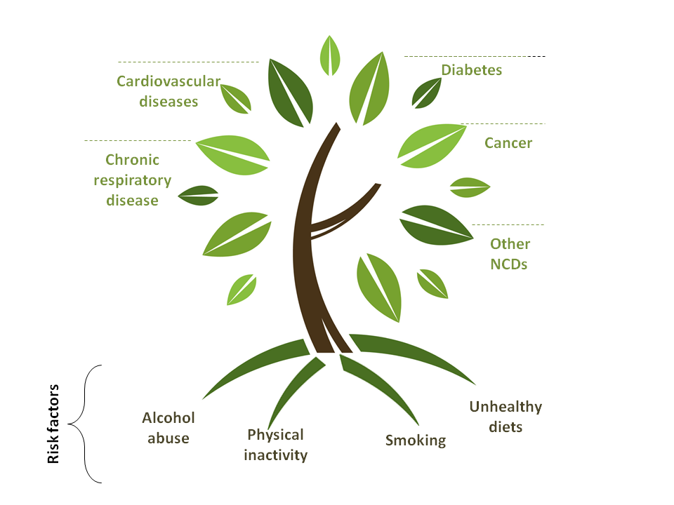
Non-communicable diseases

Slide 14
What is Lifestyle?
Lifestyle indicates the behavioral patterns which we routinely adopt and the way we tend to (involuntarily) live our daily life, unless coerced to change by some external stimulus.
Lifestyle is mainly dependent on psycho - social and environmental factors and, to a smaller extent, on genetic influences.
Non-communicable diseases

Slide 15
Lifestyle is developed in the form of a set pattern of behavior, very gradually, over many years, in the way we eat, drink, exercise, use intoxicants, are predisposed to own health care and personal protection, sexual practices.
Since these behavioral patterns are acquired very gradually, changing them becomes a difficult proposition and needs a lot of persuasiveness as well as persistent approach on the part of the health care providers including health educators.
Non-communicable diseases

Slide 16
Major life style diseases
Non-communicable diseases

Slide 17
What are the major components of Lifestyle:
lifestyle is more of attitudes and behaviors, about predispositions.
There are large number of components of “lifestyle” which affect health, in the form of the way we exercise, to sexual mores to habitual hand washing before eating meals.
Non-communicable diseases

Slide 18
From preventive point of view, the major facets of lifestyle are following(The Major Components of Unhealthy Lifestyle).
● Lack of physical activity
● Faulty dietary habits
● Tobacco use
● Excessive alcohol intake
● Mental Stress
● Disregard to personal safety regarding
- Accidents
- Personal hygiene
- Unsafe Sex
Non-communicable diseases

Slide 19
Socio-Environmental Changes leading to Increase Unhealthy Lifestyles
Rapid Industrialization / Market economy
Increased global earnings
Materialism / consumerism
Mechanization
Ad - Driven Competitive Food Industry
TV, Cables, VCDs
Computers, Internet
Increasing market of tobacco and alcohol, more so driven by ads
Career Competitiveness
Migration towards urban areas
Non-communicable diseases

Slide 20
Key Challenges of
Non-Communicable Diseases in Iraq
Non-communicable diseases

Slide 21
1. High Prevalence and Rising Burden
Increasing prevalence:
NCDs have been steadily increasing in Iraq, reflecting global trends.
The country's population is aging, urbanization is rising, and lifestyle changes (such as poor diet and reduced physical activity) contribute to the growing incidence of conditions like heart disease, stroke, diabetes, and cancers.
Shift from infectious to chronic diseases:
Like many other countries, Iraq is experiencing a demographic and epidemiological transition, where the burden of infectious diseases is being replaced by NCDs, which now account for a large proportion of deaths.
Non-communicable diseases

Slide 22
2. Lifestyle Factors and Risk Behaviors
Unhealthy diet: The consumption of processed foods, high in sugars, fats, and salt, is common. This dietary pattern is a major contributor to obesity, hypertension, and diabetes.
Physical inactivity: With increasing urbanization, many Iraqis lead sedentary lifestyles, which is a major risk factor for cardiovascular disease, type 2 diabetes, and certain cancers.
Smoking and tobacco use: Smoking rates are relatively high, especially among men, and tobacco use is a significant contributor to lung cancer, respiratory diseases, and cardiovascular diseases.
Alcohol consumption: While alcohol consumption is limited due to cultural and religious reasons, there are still some concerns regarding its use, particularly among certain segments of the population.
Non-communicable diseases

Slide 23
3. Healthcare Infrastructure and Access
Weak healthcare system:
Iraq's healthcare system has faced significant challenges due to years of conflict, economic instability, and underinvestment.
The system is often overwhelmed, especially in rural and conflict-affected areas, leading to limited access to essential services and a lack of specialized care for managing NCDs.
Limited healthcare resources:
There is a shortage of trained healthcare professionals, particularly in the fields of cardiology, oncology, and endocrinology.
Diagnostic and treatment facilities for chronic conditions are often inadequate, which makes early diagnosis and effective management more difficult.
Inconsistent medical supply and medication availability:
Essential drugs for treating conditions such as hypertension, diabetes, and cancer can be scarce, and supply chains are often disrupted.
Non-communicable diseases

Slide 24
4. Limited Public Awareness and Education
Lack of awareness: Public awareness about the prevention and management of NCDs remains low in Iraq. Many individuals are unaware of the risk factors for these diseases or the importance of early screening and intervention.
Limited health education programs: There is a need for widespread public health campaigns aimed at educating the population about the dangers of unhealthy behaviors such as smoking, poor diet, and lack of exercise.
Cultural and social factors: Cultural attitudes towards health, illness, and healthcare may prevent individuals from seeking care or adopting preventive measures. There may be stigma around diseases like mental illness or cancer, which further limits awareness and action.
Non-communicable diseases

Slide 25
5. Economic Burden
Cost of treatment:
The financial burden of treating NCDs can be overwhelming, particularly for individuals and families without adequate health insurance.
Many NCDs require long-term care, which is costly and often unaffordable for a significant portion of the population.
Impact on productivity:
NCDs lead to lost productivity due to illness, disability, and premature death.
This reduces the country's economic output and increases the financial strain on the healthcare system and society.
Non-communicable diseases

Slide 26
6. Impact of Conflict and Displacement
Displaced populations and healthcare disruption:
Iraq has experienced ongoing conflicts, including the war with ISIS, which has displaced millions of people and disrupted healthcare systems.
Displaced individuals often face challenges accessing regular healthcare services, including treatment for chronic conditions.
Stress and mental health issues:
Conflict and displacement contribute to high levels of mental health issues, including stress, anxiety, and depression, which in turn may exacerbate NCDs.
Mental health conditions often go unaddressed due to the stigma surrounding mental illness and the lack of mental health professionals.
Non-communicable diseases

Slide 27
7. Environmental Factors
Pollution and environmental toxins:
Air pollution, water contamination, and the effects of climate change are growing concerns in Iraq.
Exposure to pollutants can exacerbate chronic respiratory diseases and cardiovascular conditions.
Post-war environmental damage:
The legacy of conflict has left Iraq with extensive environmental damage, such as landmines and hazardous waste, which can affect public health and contribute to chronic diseases over time.
Non-communicable diseases

Slide 28
8. Aging Population
Increasing elderly population:
As the population ages, the burden of NCDs will increase, as these diseases are more common in older age groups.
The healthcare system will need to adjust to the growing needs of the elderly, including long-term care and rehabilitation.
Non-communicable diseases

Slide 29
Potential Solutions and Recommendations:
1. Strengthening Healthcare Systems
Improving healthcare infrastructure:
Iraq needs to invest in healthcare facilities, especially in underserved rural areas, and ensure that there are sufficient resources to provide care for NCD patients.
Training healthcare professionals:
Increased investment in training doctors, nurses, and specialists in the management of NCDs is crucial.
This includes fostering expertise in areas such as cardiology, endocrinology, oncology, and rehabilitation.
Non-communicable diseases

Slide 30
2. Public Health Education and Awareness
Promoting healthy lifestyles:
The government and NGOs can collaborate to create public health campaigns that promote better nutrition, physical activity, smoking cessation, and the importance of regular health checkups.
Screening and early detection programs:
Implementing nationwide screening programs for conditions like hypertension, diabetes, and cancer can help in early detection and prevention of complications.
Non-communicable diseases

Slide 31
3. Policy and Legislative Action
Tobacco control and regulation:
Strengthening laws around tobacco control, including public smoking bans, taxes on tobacco products, and anti-smoking education, could reduce tobacco-related NCDs.
Regulation of unhealthy foods:
Introducing taxes on unhealthy food products, labeling laws, and encouraging healthier food options in schools and public institutions can help curb the growing problem of obesity and related diseases.
Non-communicable diseases

Slide 32
4. Addressing Social Determinants of Health
Improving socio-economic conditions:
Economic development and poverty reduction efforts can reduce the social determinants of health, such as access to nutritious food, healthcare, and education.
Access to affordable healthcare:
Ensuring that healthcare is accessible and affordable for all citizens, particularly the poor and displaced populations, will be crucial for managing NCDs effectively.
Non-communicable diseases

Slide 33
5. International Collaboration and Support
Leveraging international aid:
Iraq can benefit from international support, including financial aid, technical assistance, and capacity-building efforts to address the rising burden of NCDs.
Non-communicable diseases

